Slide 1
sound flow
Maedeh Sharifi

Slide 2
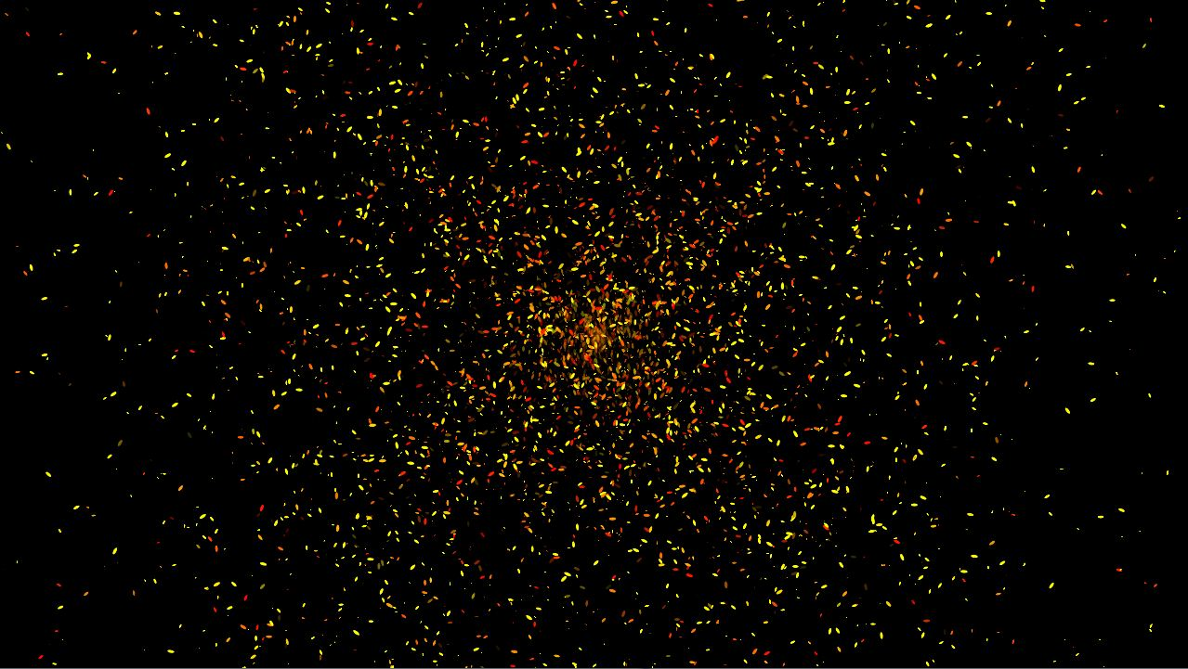
Concept
Sound Flow is a concrete visualisation of sound in a 2D open space.
The end product is a wall projection displaying moving particles representing the ambient sound of the room.
The particles are from the pixels of the video from a webcam input capturing the people inside the room.
The particles move in various directions depending on the volume of sound in various sections of the room.

Slide 3
Research sources and inspiration
Digital interactive wall in Berlin
This art experiment was a source of inspiration for my project because it uses a tangible space (a wall) in order for the user to interact with it. I like the idea of the visual feedback to be outside of a computer screen and to be integrated into an open space. The user feels more compelled to play with the art piece since it is something out of the ordinary and it has a certain “magical” feel to it. https://mindsparklemag.com/video/digital-interactive-wall-in-berlin/

Slide 4
Research sources and inspiration (2)
The Interactive Wall Installation by Siddharth Mankad
This art experiment greatly inspired me when choosing the concept of my project. I found the idea of using projections to further enhance the performance of the artist to be very interesting and creative. The interactive aspect of the project adds a certain magical effect to the visual projection since it is connected in real time to the performer’s movements. Youtube video: https://www.youtube.com/watch?v=OGoZktCzMS4 Github URL: https://github.com/smmankad/float

Slide 5
Research sources and inspiration (3)
Virtual Gulf Stream Aquarium: Interactive Digital Wall Projection
I found the Virtual Aquarium from the museum of sciences in Miami to be another very interesting concept which pushes the user to interact with the elements inside the projection. However similarly the previous examples, the input to the project is through the physical movements of the user. For my interactive wall, I wanted the input to be different and that is the reason why I chose sound instead.
Link: https://www.youtube.com/watch?v=pBIE8QF8oy8

Slide 6
Similar work by other artists
Flow series from Waltz Binaire in an interactive wall projection which displays particles in the shape of the user dancing using motion data. https://www.youtube.com/watch?v=ISKV1BeB3pM
Sound Visualisation made by Franziska Franke using processing https://www.youtube.com/watch?v=vV7BSwtB8_I
fluidWaves is a sound visualisation made by FE1 using processing https://vimeo.com/13911664 www.futura-epsis1.com

Slide 7
Project scope
My project will not only require me to work on the code aspect but also to test the art piece in a room with 3 microphones and with the projection playing. Therefore I should plan to finish the code at least 2 weeks before the due date in order to have enough time for testing and modifications if necessary. I plan on using the in class information about particles alongside a sound library (minim) and possibly the particleFlow library to construct my code.

Slide 8
computational model components
1. Sound information. Analog data coming from 3 microphones put inside the room. One in the right side of the room, one in the center and on in the left side.
2. Video taken from a webcam capture.
3. Particles. The color data will be provided by the video capture of a webcam. The position of the particles is dependent on the volume of each microphone. If the volume of a section is higher, the concentration of particles in that area will be greater. The size of the particles in each section will depend on the frequency of sound. Lower frequencies will produce bigger and less active particles while higher frequencies will produce smaller and more active particles. 4. Projection image displays particles in their respective position and color.
5. The background will be transparent in order for the user to see the wall. And for the projection to not be easily delimited in space.

